Slide 1

SCS1301 - OPERATING SYSTEM
UNIT – III
SYNCHRONIZATION AND DEADLOCKS
Dr.S.PRAYLA SHYRY
Assoc. Professor
Dept. of Computer Science and Engineering
School of Computing

Slide 2
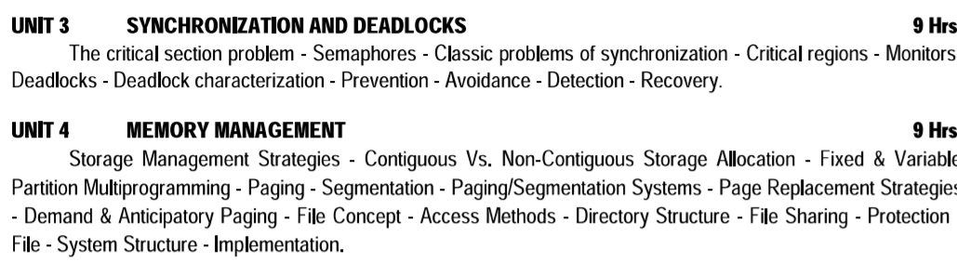

Slide 3
COOPERATING PROCESSES
Processes executing concurrently in the operating system may be either independent processes or cooperating processes.
A process is independent if it cannot affect or be affected by the other processes executing in the system.
Any process that does not share data with any other process is independent.
There are several reasons for providing an environment that allows process cooperation:
INFORMATION SHARING
COMPUTATION SPEEDUP
MODULARITY
CONVENIENCE
BUFFER

Slide 4
COOPERATING PROCESSES
INFORMATION SHARING:
Since several users may be interested in the same piece of information (for instance, a shared file), we must provide an environment to allow concurrent access to such information.
COMPUTATION SPEEDUP:
If we want a particular task to run faster, we must break it into subtasks, each of which will be executing in parallel with the others.
MODULARITY:
We may want to construct the system in a modular fashion, dividing the system functions into separate processes or threads
CONVENIENCE
Even an individual user may work on many tasks at the same time

Slide 5
COOPERATING PROCESSES
A cooperating process is one that can affect or be affected by other process executing in the system
Cooperating process
Directly share a logical address data space (i.e. code & data) - This may result in data inconsistency. It is implemented on threads.
Share data only through files/ messages - So we will deal with various to order....orderly execution of cooperating process so that data consistency is maintained.

Slide 6
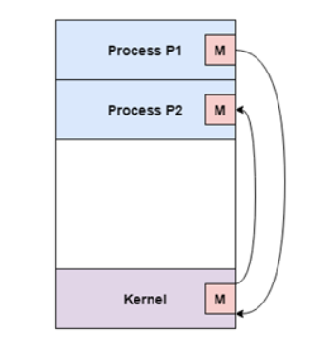
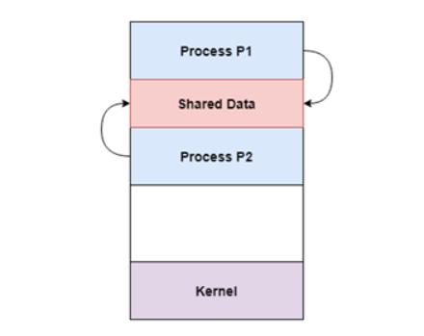
Cooperation by Sharing
Cooperation by Communication

Slide 7
Example- producer-consumer problem
Also Known as bounded buffer problem.
(a print program produces characters that are consumed by the printer driver)
Problem describes two processes
1. Producer
2. Consumer
They share a common fixed Size buffer
Producer: Generate a piece of data, put it into the buffer and start again
Consumer: Consuming the data(removing the data from the buffer)one piece at a time.

Slide 8

Problem?

Slide 9
Solution?
Solution from producer side
Producer goes to sleep mode or discard data if the buffer is full
Consumer removes the data from the buffer and it notifies the producer
Solution from Consumer side
Consumer goes to sleep mode if the buffer is found to be empty
The very next time when the producer puts data in the buffer ,it wakes the consumer

Slide 10
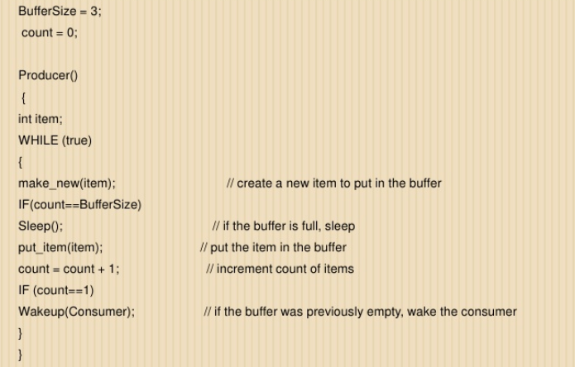
Producer Side

Slide 11
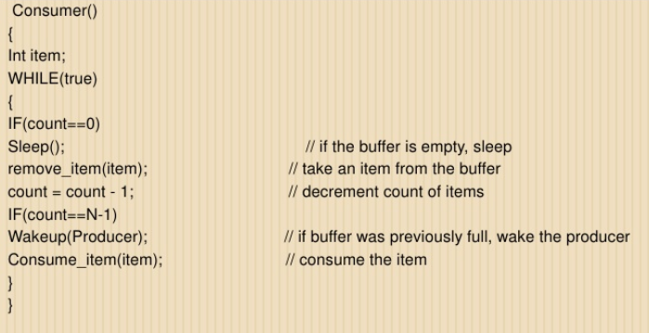
Consumer Side

Slide 12
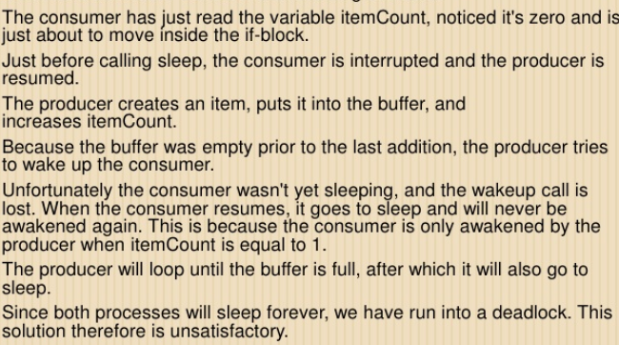
Race condition ….(leads to deadlock)

Slide 13
Race condition
When several processes access and manipulate the same data concurrently and the outcome of the execution depends on the particular order in which the access takes place is called race condition
To guard against the race condition, we need to ensure that only one process at a time can be manipulating the variable counter.
Hence processes must be synchronized.

Slide 14
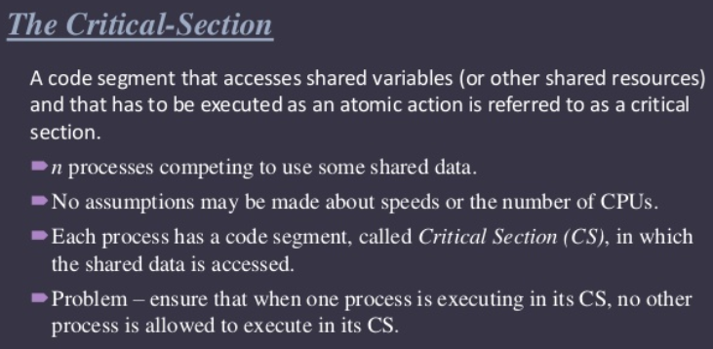
Critical Section Problem

Slide 15
Critical Section Problem
The critical section problem is to design a protocol that the processes can use to co- operate.
Each process must request permission to enter its critical section.
The section of code implementing this request is the entry section.
do
{
Entry Section
Critical Section
Exit Section
Remainder Section
}while(TRUE);
General Structure of a typical process Pi.

Slide 16
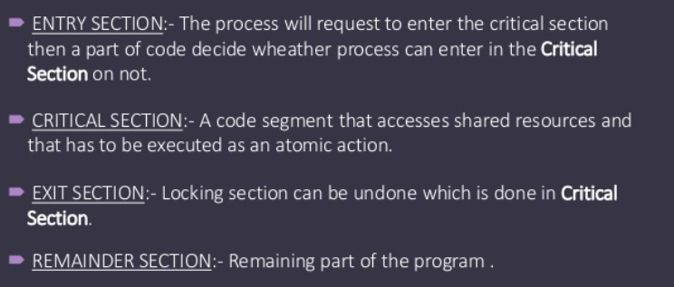

Slide 17
A critical section is a piece of code that only one thread can execute at a time.
If multiple threads try to enter a critical section, only one can run and the others will sleep.
Imagine you have three threads that all want to enter a critical section.
Only one thread can enter the critical section; the other two have to sleep.
When a thread sleeps, its execution is paused and the OS will run some other thread.
Once the thread in the critical section exits, another thread is woken up and allowed to enter the critical section.

Slide 18
Requirements to the critical section
Three requirements:
Mutual exclusion:
If a process is executing in critical section, then no other process can
be executing in their critical section.
Only one process can execute at a time
This means access to the critical section must be mutually exclusive.
2. Progress:
If no process is executing in its critical section and some processes wish to enter their critical sections, then only those processes that are not executing in their remainder sections can participate in the decision on which will enter its critical section next and this selection cannot be postponed indefinitely.
If only one process wants to enter, it should be able to
If two or more wish to enter, one of them should succeed

Slide 19
Contd..,
Bounded waiting:
There exists a bound or limit on the number of times that other processes are allowed to enter their critical section after a process has made a request to enter its critical section and before that request is granted.
Assume that each process executes at a non zero speed

Slide 20
Critical Regions
A critical region is a section of code that is always executed under mutual exclusion.
Critical regions shift the responsibility for enforcing mutual exclusion from the programmer (where it resides when semaphores are used) to the compiler.
Two parts:
1. Variables that must be accessed under mutual exclusion.
2. A new language statement that identifies a critical region in which the variables are accessed.

Slide 21
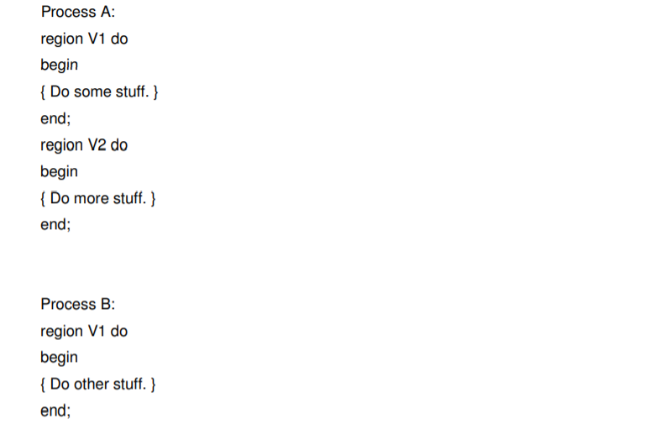
Example:
Here process A can be executing inside its V2 region while process Bis executing inside
its V1 region, but if they both want to execute inside their respective V1 regions only one
will be permitted to proceed.
Each shared variable (V1 and V2 above) has a queue associated with it. Once one process is executing code inside a region tagged
with a shared variable, any other processes that attempt to enter a region tagged with the same variable are blocked and put in the
queue.

Slide 22
Conditional Critical Regions
Lack of condition synchronization
Conditional critical regions provide condition synchronization for critical regions:
region v when B do
begin ... end; where B is a boolean expression (usually B will refer to v).
Conditional critical regions work as follows:
A process wanting to enter a region for v must obtain the mutex lock. If it cannot, then it is queued.
Once the lock is obtained the boolean expression B is tested. If B evaluates to true then the process proceeds, otherwise it releases the lock and is queued.
When it next gets the lock it must retest B. ndition synchronization

Slide 23
Explanation
Each shared variable has two queues associated with it.
The main queue is for processes that want to enter a critical region but find it locked.
The event queue is for the processes that have blocked because they found the condition to be false.
When a process leaves the conditional critical region the processes on the event queue join those in the main queue.
Limitations
Conditional critical regions are still distributed among the program code.
There is no control over the manipulation of the protected variables — no information hiding or encapsulation.
Once a process is executing inside a critical region it can do whatever it likes to the variables it has exclusive access to.
Conditional critical regions are more difficult to implement efficiently than semaphores.

Slide 24
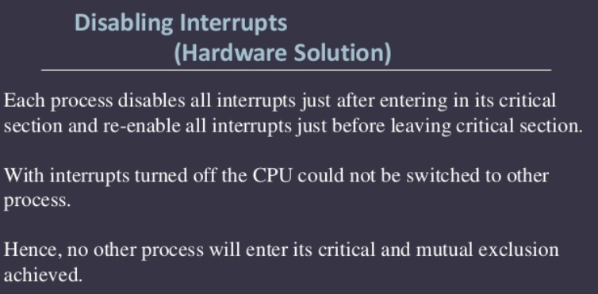
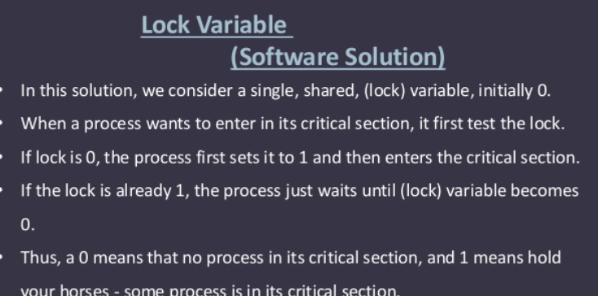

Slide 25
Semaphore
A semaphore –
Variable whose value indicates the status of a common resource.
Its purpose is to lock the resource being used.
A process which needs the resource will check the semaphore for determining the status of the resource followed by the decision for proceeding.
In multitasking operating systems, the activities are synchronized by using the semaphore techniques.
Accessed only through standard atomic operations: wait() and signal().

Slide 26
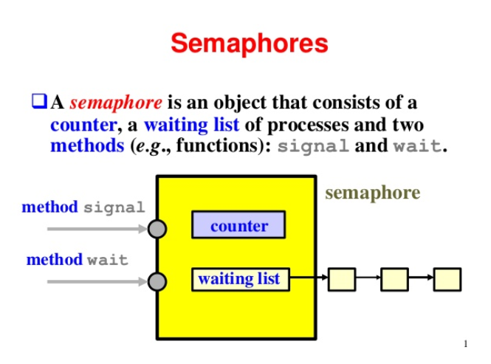
Semaphore

Slide 27
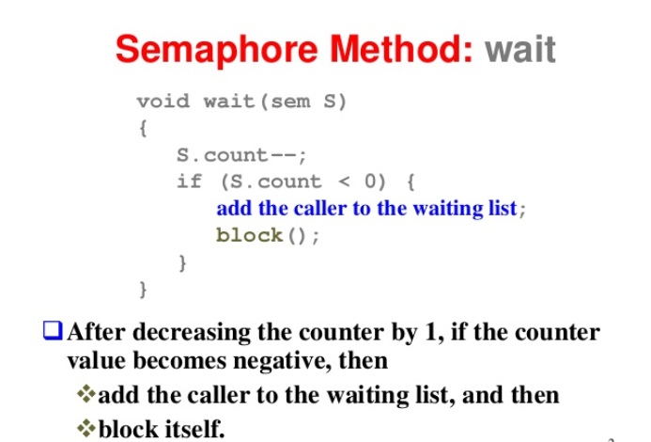
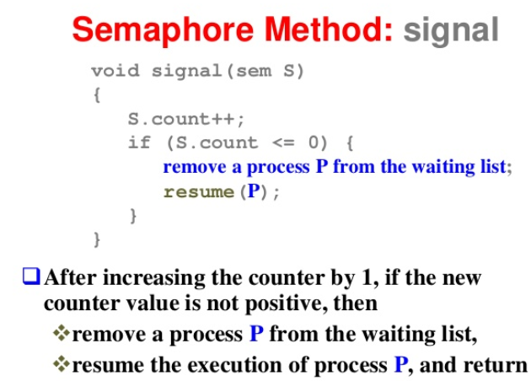

Slide 28
Contd..,
Modifications to the integer value of the semaphore in the wait() and signal() operations must be executed indivisibly.
When one process modifies the semaphore value, no other process can simultaneously modify that same semaphore value.

Slide 29
Types of semaphores
Binary semaphores Binary semaphores have 2 methods associated with it. (up, down / lock, unlock) Binary semaphores can take only 2 values (0/1). They are used to acquire locks. When a resource is available, the process incharge set the semaphore to 1 else 0.
Binary semaphores are known as mutex locks as they are locks that
provide mutual exclusion Counting semaphores Counting Semaphore may have value to be greater than one, typically used to allocate resources from a pool of identical resources

Slide 30
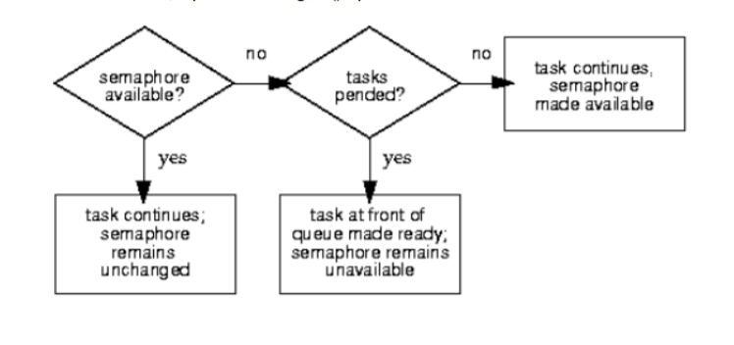

Slide 31
Binary Semaphore
Process A performs the acquire first and therefore is provided with the semaphore.
The period in which the semaphore is owned by the process is commonly called a critical section.
The critical section can be performed by only one process, therefore the need for the coordination provided by the semaphore.
While Process A has the semaphore, Process B is not permitted to perform its critical section.
Note that while Process A is in its critical section, Process B attempts to acquire the semaphore.
As the semaphore has already been acquired by Process A, Process B is placed into a blocked state. When Process A finally releases the semaphore, it is then granted to Process B, which is allowed to enter its critical section.
Process B at a later time releases the semaphore, making it available for acquisition.

Slide 32
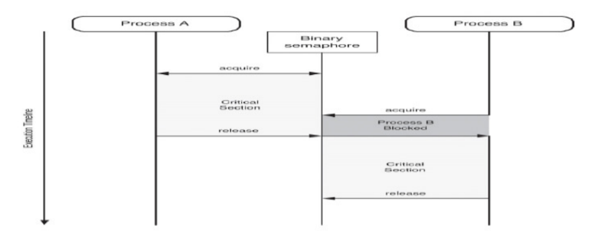

Slide 33
Counting Semaphores
Each process requires two resources before being able to perform its desired activities.
The value of the counting semaphore is 3, which means that only one process will be permitted to fully operate at a time.
Process A acquires its two resources first, which means that Process B blocks until Process A releases at least one of its resources.

Slide 34
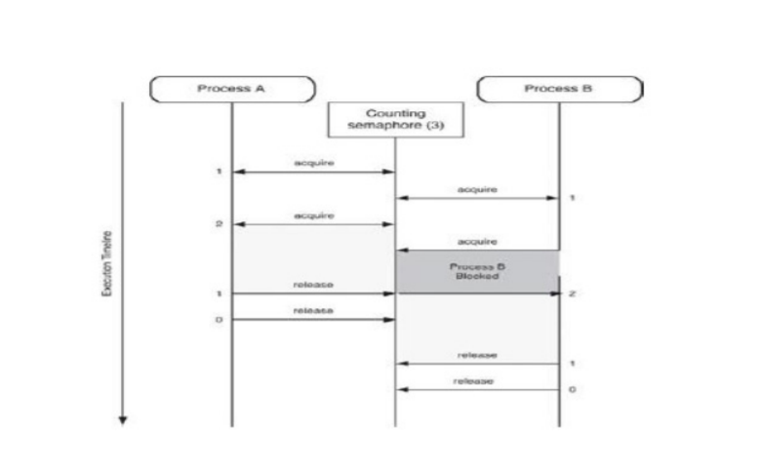

Slide 35
Advantages of Semaphores
Semaphores allow only one process into the critical section. They follow the mutual exclusion principle strictly and are much more efficient than some other methods of synchronization.
There is no resource wastage because of busy waiting in semaphores as processor time is not wasted unnecessarily to check if a condition is fulfilled to allow a process to access the critical section.
Semaphores are implemented in the machine independent code of the microkernel. So they are machine independent.
Disdavantage:
Semaphores are impractical for last scale use as their use leads to loss of modularity. This happens because the wait and signal operations prevent the creation of a structured layout for the system.

Slide 36
Disadvantages of Semaphores
While a process is in its critical section, other process that tries to enter its critical section must loop continuously in the entry code.
Busy waiting wastes CPU cycles that some other process might be able to use productively. This type of semaphore is called a spinlock because the process spins while waiting for the lock
Solution:
Rather than engaging in busy waiting, the process can block itself. The block operation places a process into a waiting queue associated with the semaphore and the state of the process is switched to the waiting state.
Then control is transferred to CPU scheduler which selects another process to execute.
A process that is blocked waiting on a semaphore S, should be restarted when some other process executes a signal() operation.
The process is restarted by a wakeup() operation which changes the process from the waiting state to the ready state. Process is then placed in the ready queue.

Slide 37
Functions
Wait() semaphore operation
Signal() semaphore operation
Signal(semaphore *S) {
S->value++;
if (S->value <= 0) {
remove a process P from S->list;
wakeup(P);
}
}
wait(semaphore *S)
{
S->value—;
if (S->value < 0)
{ add this process to S->list; block();
}
}

Slide 38
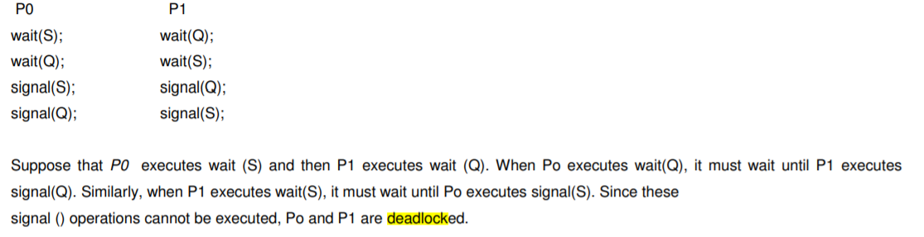
Deadlocks and Starvation
The implementation of a semaphore with a waiting queue may result in a situation where two or more processes are waiting indefinitely for an event that can be caused only by one of the waiting processes
The event in question is the execution of a signal()operation. When such a state is reached, these processes are said to be deadlocked.

Slide 39
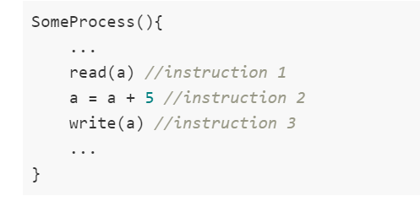
Classic problems of synchronization
In the Operating System, there are a number of processes present in a particular state.
At the same time, we have a limited amount of resources present, so those resources need to be shared among various processes.
Ensure that no two processes are using the same resource at the same time because this may lead to data inconsistency.
So, synchronization of process should be there in the Operating System.(race condition, critical section)
Race Condition

Slide 40
Classic problems of synchronization
Case 1
Process P1 will be executed fully (i.e. all the three instructions) and after that, the process P2 will be executed.
Case 2
P1 starts executing. So, it reads the value of "a" from the memory and that value is 10(initial value of "a" is taken to be 10). Now, at this time, context switching happens between process P1 and P2
the execution of the process that is present in the running state is suspended by the kernel and another process that is present in the ready state is executed by the CPU.
Outcome of the execution depends on the particular order in which the access takes place(race condition)

Slide 41
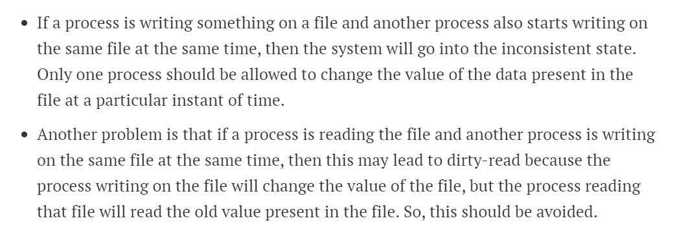
Reader Writer –Problem statement
Solution is …..using semaphore

Slide 42
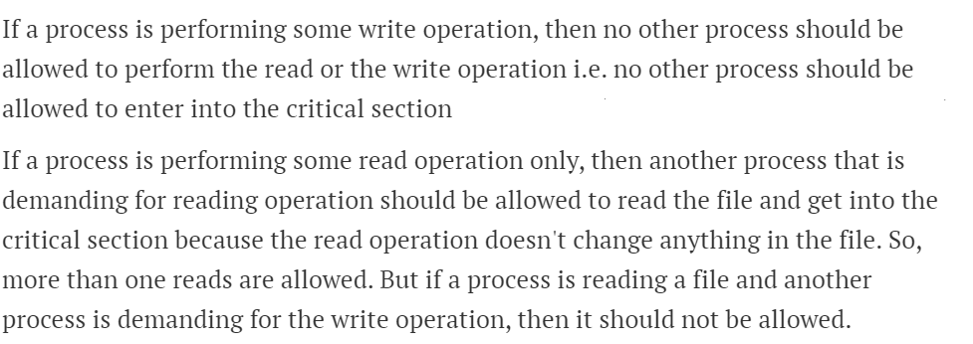

Slide 43
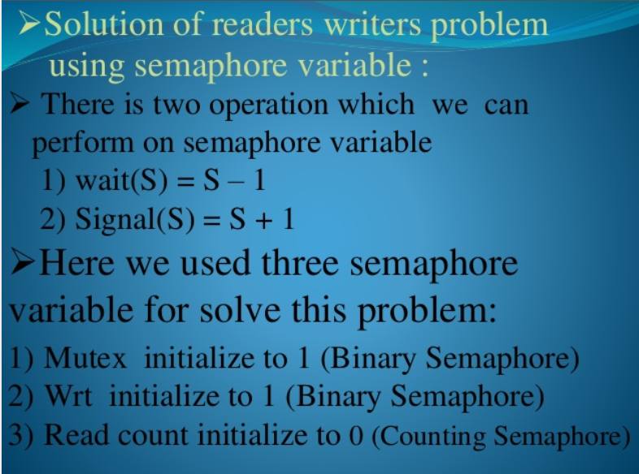

Slide 44
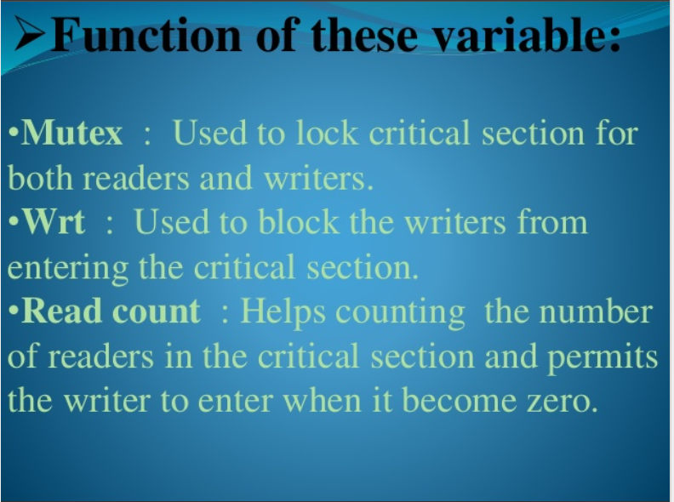

Slide 45
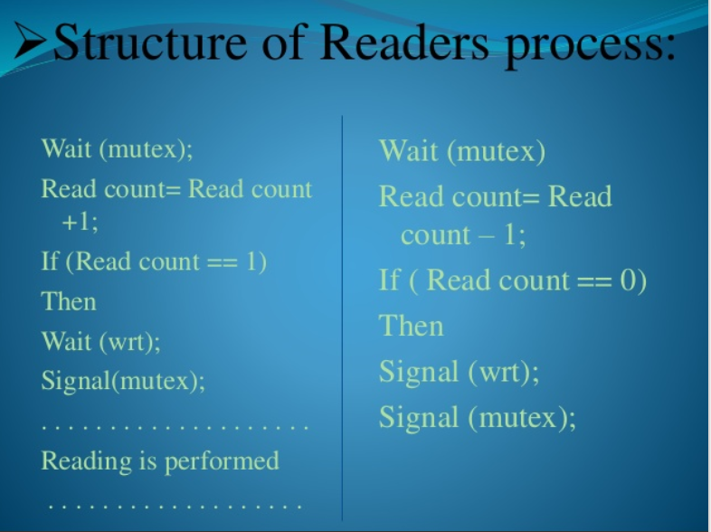
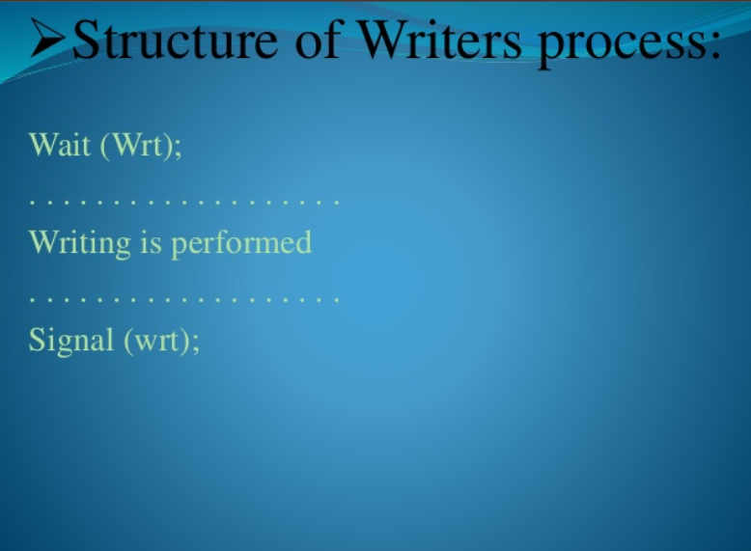
Structure of Reader –Writer Process

Slide 46
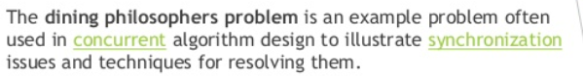
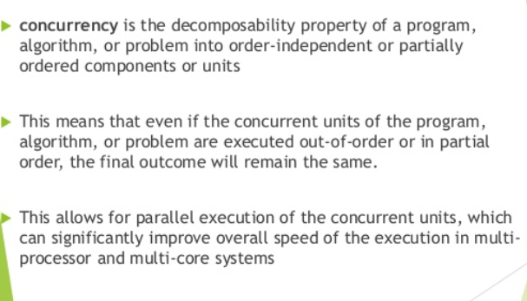
Dining philosopher

Slide 47
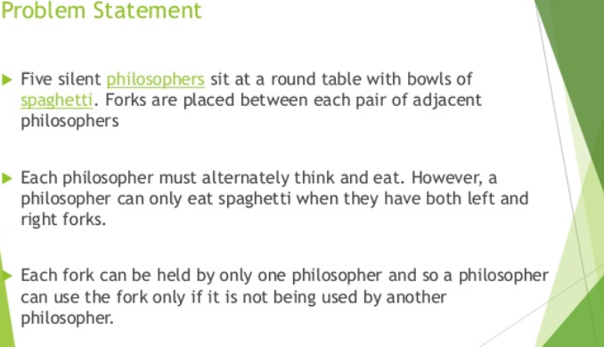

Slide 48
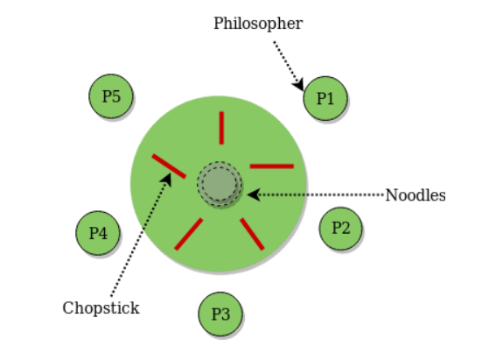
Explanation
At any instant, a philosopher is either eating or thinking. When a philosopher wants to eat, he uses two chopsticks - one from their left and one from their right. When a philosopher wants to think, he keeps down both chopsticks at their original place.
From the problem statement, it is clear that a philosopher can think for an indefinite amount of time. But when a philosopher starts eating, he has to stop at some point of time. The philosopher is in an endless cycle of thinking and eating.

Slide 49
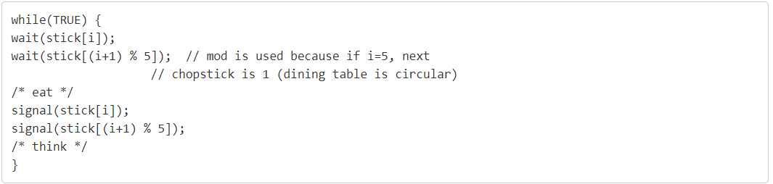
Solution with semaphore
When a philosopher wants to eat the rice or spaghetti , he will wait for the chopstick at his left and picks up that chopstick. Then he waits for the right chopstick to be available, and then picks it too. After eating, he puts both the chopsticks down.
But if all five philosophers are hungry simultaneously, and each of them pickup one chopstick, then a deadlock situation occurs because they will be waiting for another chopstick forever.
A philosopher must be allowed to pick up the chopsticks only if both the left and right chopsticks are available.
Allow at most four philosophers to be sitting simultaneously at the table
Use an asymmetric solution; that is, an odd philosopher picks up first her left chopstick and then her right chopstick whereas an even philosopher picks up her right chopstick and then her left chopstick.

Slide 50
Problems in semaphore
Although semaphores provide a convenient and effective mechanism for process synchronization, using them incorrectly can result in timing errors that are difficult to detect since these errors happen only if some particular execution sequences take place and these sequences do not always occur.
Case 1
Suppose that a process interchanges the order in which the wait () and signal () operations on the semaphore mutex are executed.
Signal (mutex); …….
Critical section ……..
Wait (mutex);
Here several processes may be executing in their critical sections simultaneously, violating the mutual exclusion requirement.

Slide 51
Problems in semaphore
Case 2
Suppose that a process replaces signal (mutex) with wait (mutex) that is it executes
Wait(mutex); ……
Critical section …….
Wait(mutex);
Here a deadlock will occur.
Case 3:
Suppose that a process omits the wait(mutex), or the signal(mutex) or both. Here, either mutual exclusion is violated or a dead lock will occur

Slide 52
Monitor - high level synchronization
Presents a set of programmer defined operations that are provided mutual exclusion within the monitor.
The monitor type also contains the declaration of variables whose values define the state of an instance of that type, along with the bodies of the procedures or functions that operate on those variables.
The representation of a monitor type cannot be used directly by the various processes.
Thus, a procedure defined within a monitor can access only those variables declared locally within the monitor and its formal parameters.
The local variables of a monitor can be accessed by only the local procedures.

Slide 53
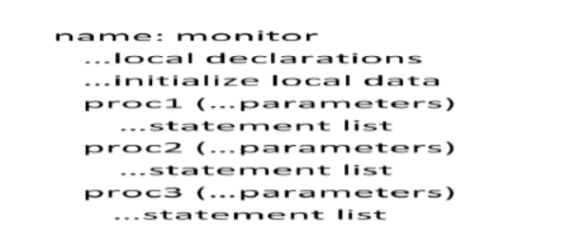
Ensures that only one process at a time can be active within the monitor. But this monitor construct is not powerful for modeling some synchronization schemes.
To make more powerful..we use condition construct.
The only operations that can be invoked on a condition variable are wait() and signal(). The operation x.wait() means that the process invoking this operation is suspended until another process invokes x.signal().
The x.signal() operation resumes exactly one suspended process.
When x.signal() operation is invoked by a process P, there is a suspended process Q associated with condition x.
If suspended
process Q is allowed to resume its execution, the signaling process P must wait.
Otherwise, both P and Q would be active simultaneously within the monitor

Slide 54
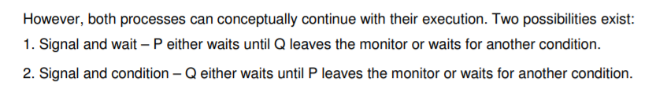

Slide 55
Dining Philosophers Solution using Monitors
Solution imposes the restriction that a philosopher may pick up her chopsticks only if both of them are available.
Three states of philosopher: Hungry,Eating,Thinking
THINKING – When philosopher doesn’t want to gain access to either fork.
HUNGRY – When philosopher wants to enter the critical section.
EATING – When philosopher has got both the forks, i.e., he has entered the section.
Philosopher i can set the variable state[i] = EATING only if her two neighbors are not eating (state[(i+4) % 5] != EATING) and (state[(i+1) % 5] != EATING).

Slide 56
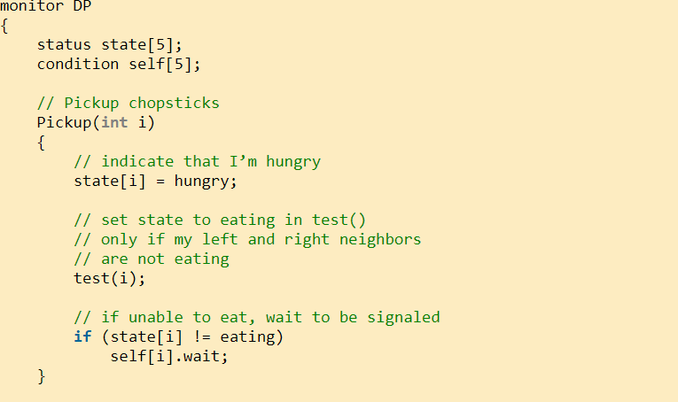
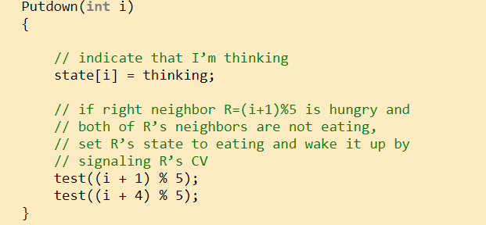

Slide 57
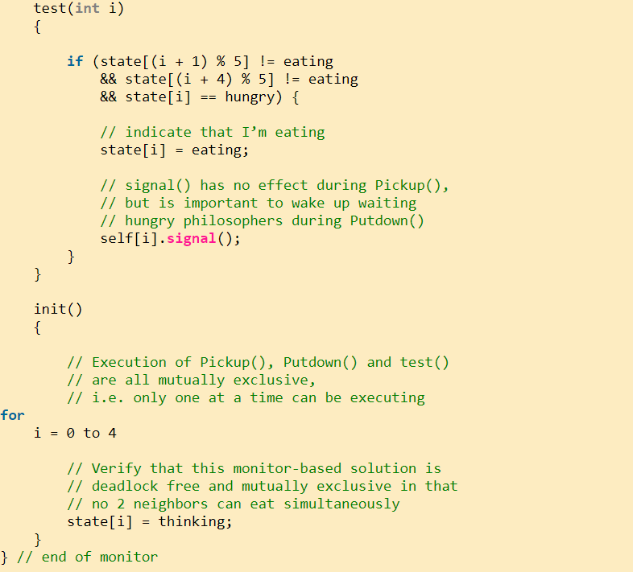

Slide 58
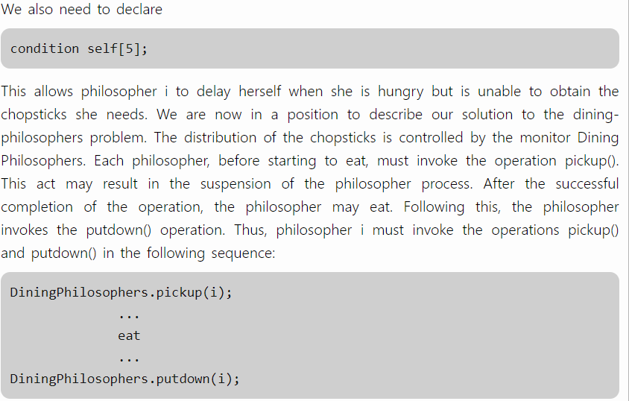
Philosopher i must
invoke the operations pickup() and putdown() in the following sequence:

Slide 59
Implementing a Monitor using Semaphores
For each monitor, a semaphore mutex initialized to 1 is provided.
A process must execute wait(mutex) before entering the monitor and must execute(signal) after leaving the monitor.
Since a signaling process must wait until the resumed process either leaves or waits, an additional semaphore next initialized to 0, on which the signaling processes may suspend themselves.
An integer variable next_count is used to count the number of processes suspended on next.
Thus, each external procedure P is replaced by
wait(mutex);
body of F
if (next_count > 0)
signal(next);
else
signal(mutex);
Mutual exclusion within a monitor is thus ensured.

Slide 60
Resuming Processes Within a Monitor
If several processes are suspended on condition x, and an x.signal() operation is executed by some process, then for determining which suspended process should be resumed next, we use FCFS ordering so that the process waiting the longest is resumed first.
Or conditional wait construct() can be used as x.wait(c); where c is an integer expression that is evaluated when the wait () operation is executed.
The value of c, which is called a priority number, is then stored with the name of the process that is suspended.
When x. signal () is executed, the process with the smallest associated priority number is resumed next.

Slide 61
A monitor to allocate a single resource
ResourceAllocator monitor controls the allocation of a single resource among competing processes.
Each process, when requesting an allocation of this resource, specifies the maximum time it plans to use the resource.
The monitor allocates the resource to the process that has the shortest timeallocation request.
A process that needs to access the resource in question must observe the following sequence:
R.acquire(t);
access the resource;
R. release O ;

Slide 62
Problems:
• A process might access a resource without first gaining access permission to the resource.
• A process might never release a resource once it has been granted access to the resource.
A process might attempt to release a resource that it never requested.
• A process might request the same resource twice (without first releasing the resource).
Solutions:
Inspect all the programs that make use of the ResourceAllocator monitor and its managed resource.
Check two conditions to establish the correctness of this system.
First, user processes must always make their calls on the monitor in a correct sequence.
Second, Ensure that an uncooperative process does not simply ignore the mutual-exclusion gateway provided by the monitor and try to access the shared resource directly, without using the access protocols.

Slide 63
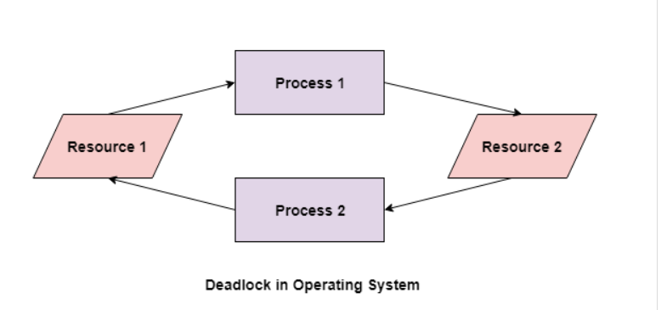
Deadlock
A deadlock happens in operating system when two or more processes need some resource to complete their execution that is held by the other process.

Slide 64
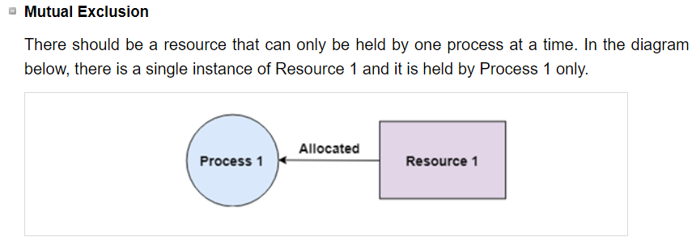
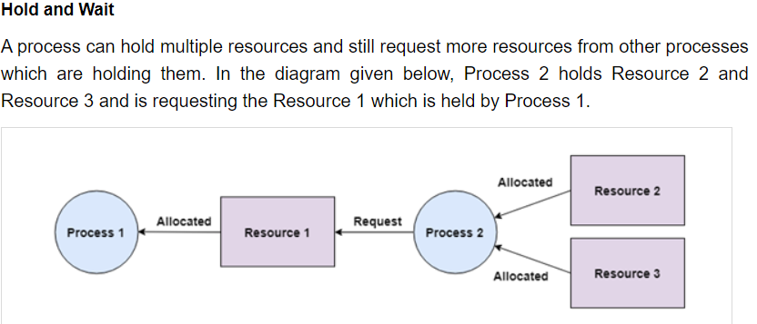
Coffman conditions

Slide 65
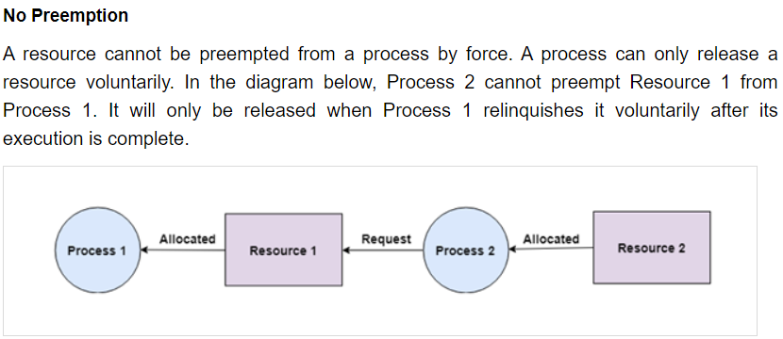
Coffman conditions

Slide 66
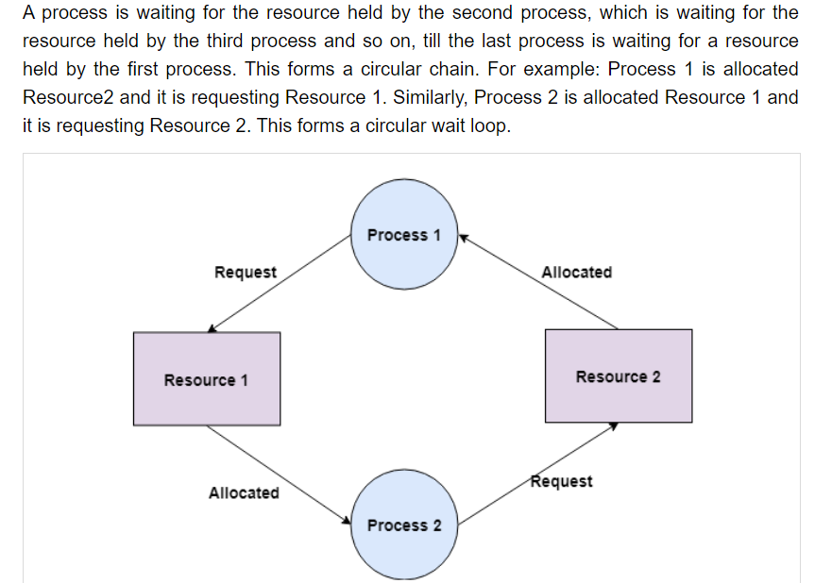
Coffman conditions
Circular Wait

Slide 67
Resource Allocation Graph (RAG) in Operating System
what is the state of the system in terms of processes and resources.
how many resources are available, how many are allocated and what is the request of each process.
Everything can be represented in terms of the diagram.
RAG | Table
possible to see a deadlock directly by using RAG if the system contains less number of process and resource. | Not easy as RAG better if the system contains lots of process and resource

Slide 68
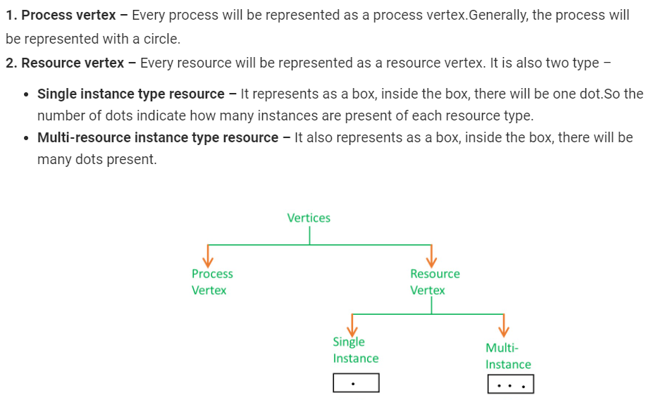
RAG

Slide 69
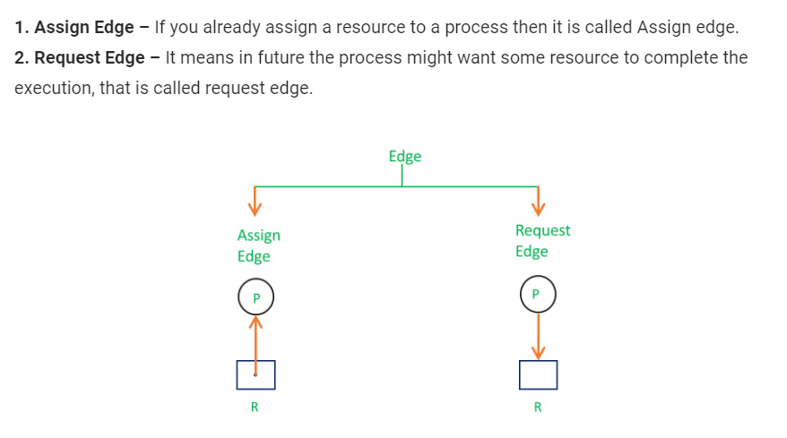
RAR-EDGES

Slide 70
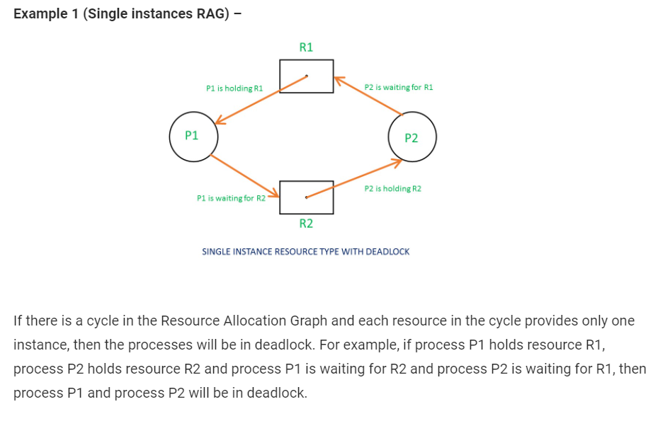

Slide 71
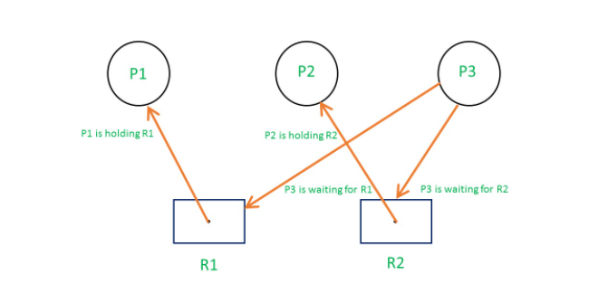
Single instance resource type with deadlock

Slide 72
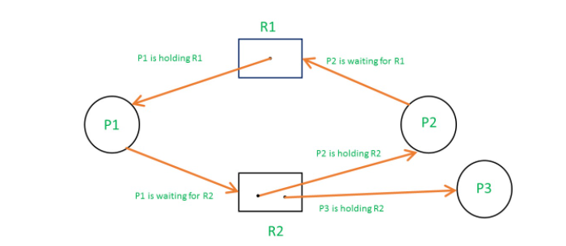
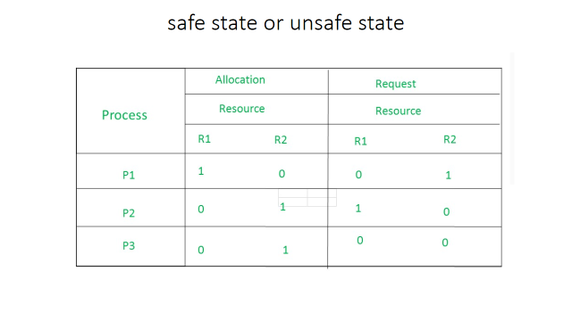
Multi instance resource type without deadlock

Slide 73
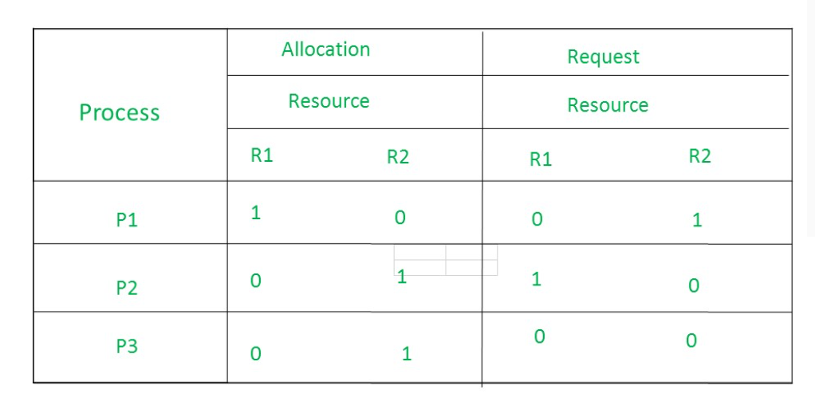
safe state or unsafe state

Slide 74
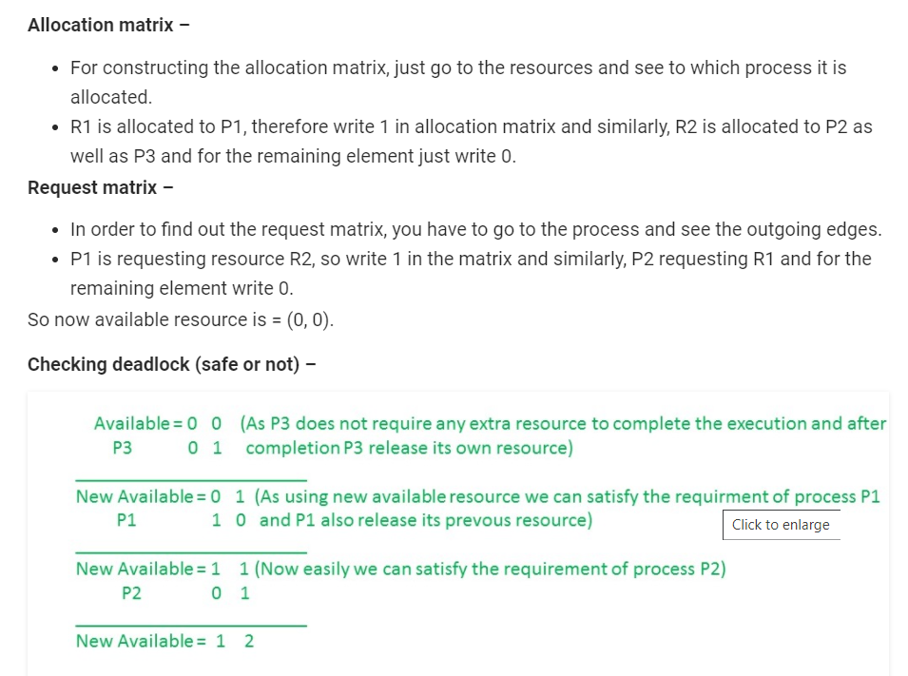
There is no deadlock in this RAG.
Even though there is a cycle, still there is no deadlock.
Therefore in multi-instance resource cycle is not sufficient condition for deadlock.

Slide 75
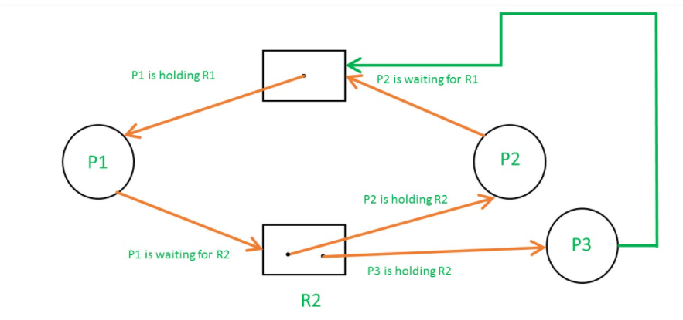

So,the Available resource is = (0, 0), but requirement are (0, 1), (1, 0) and (1, 0).So you can’t fulfill any one requirement.Therefore, it is in deadlock.

Slide 76
Deadlock Avoidance
Requires that the system has some additional or priori information available.
Simplest and most useful model requires that each process declare the maximum number of resources of each type that it may need.
The deadlock-avoidance algorithm dynamically examines the resource-allocation state to ensure that there can never be a circular-wait condition.
Resource-allocation state is defined by the number of available and allocated resources, and the maximum demands of the processes.

Slide 77
Safe State
When a process requests an available resource, system must decide if immediate allocation leaves the system in a safe state.
System is in safe state if there exists a safe sequence of all processes.
Sequence is safe if for each Pi, the resources that Pi can still request can be satisfied by currently available resources + resources held by all the Pj,
If Pi resource needs are not immediately available, then Pi can wait until all Pj have finished.When Pj is finished, Pi can obtain needed resources, execute, return allocated resources, and terminate.
When Pi terminates, Pi+1 can obtain its needed resources, and so on.

Slide 78

Safe, Unsafe , Deadlock State
If a system is in safe state ⇒ no deadlocks
If a system is in unsafe state ⇒ possibility of deadlock.
Avoidance ⇒ ensure that a system will never enter an unsafe state.

Slide 79

Resource-Allocation Graph Algorithm
• Claim edge Pi → Rj indicated that process Pi may request resource Rj; represented by a dashed line.
• Claim edge converts to request edge when a process requests a resource.
• When a resource is released by a process, assignment edge reconverts to a claim edge
• Resources must be claimed a priori in the system.

Slide 80
Bankers algorithm
Banker's Algorithm is used majorly in the banking system to avoid deadlock. It helps to identify whether a loan will be given or not.
Used to test for safely simulating the allocation for determining the maximum amount available for all resources.
It also checks for all the possible activities before determining whether allocation should be continued or not.
For example, there are X number of account holders of a specific bank, and the total amount of money of their accounts is G.
When the bank processes a car loan, the software system subtracts the amount of loan granted for purchasing a car from the total money ( G+ Fixed deposit + Monthly Income Scheme + Gold, etc.) that the bank has.
It also checks that the difference is more than or not G.
It only processes the car loan when the bank has sufficient money even if all account holders withdraw the money G simultaneously.

Slide 81
Explanation
I have $24 with me. And I want to share it with three of my friends(A,B,C), A needs $8 dollars, B needs $13, and C needs $10.
I have already lent $6 to A, $8 to B, and $7 to C, So I am left with $24 – $21 (6+8+7) = $3
Even after giving $6 to A, she still needs $2. Similarly, B needs $5 more and c $3.
Until they get the amount they need, they can neither do whatever tasks they have to nor return the amount they borrowed.
So I can pay $2 to A, and wait for her to get her work done and then get back the entire $8.
Or, I can pay $3 to C and wait for her to pay me back after task is done.
I can’t pay B because she needs $5 and I don’t have enough.
I can pay her once A or C returns the borrowed amount after their work is done.
This state is termed as the safe state, where everyone’s task is completed and, eventually, I will get all my money back.

Slide 82
Unsafe state or Deadlock state
Knowing B needs $10 urgently, instead of giving $8, I end up giving $10.
And I am left with only $1.
In this state, A still needs $2 more, B needs $3 more, and still needs $3 more, but now I don’t have enough money to give them and until they complete the tasks they need the money for, no money will be transferred back to me.
This kind of situation is called the Unsafe state or Deadlock state, which is solved using Banker’s Algorithm.
The goal of the Banker’s algorithm is to handle all requests without entering into the unsafe state, also called a deadlock.

Slide 83


Slide 84



Slide 85


Slide 86
Deadlock Detection
A Deadlock detection algorithm, determines whether the system is in deadlock state or not?
If yes, then the system uses a deadlock recovery method to break the deadlock
Two deadlock detection methods depending upon the number of instances of each resource.
1. Single Instance of Each Resource: wait-for-graph
2. Multiple Instance of Each Resource

Slide 87

Single Instance of Each Resource: wait-for-graph
Pi → Pj if Pi is waiting for Pj, Periodically invoke algorithm that searches for a cycle in the graph.
An algorithm to detect a cycle in a graph requires an order of n² operations, where n is the number of vertices in the graph.

Slide 88


Multiple Instance of Each Resource

Slide 89


Example for deadlock detection

Slide 90

Invoke detection algorithm?

Slide 91
Deadlock Recover
Process termination
Terminate all the deadlocked processes.(killing the Process)
Terminate processes one by one until the deadlock is broken. However, the issue is to decide which process to terminate.
Certain factors that can be used are:
How long the process has computed?
How much the process has finished its working?
What is the priority of the process?
How many resources are being used by the process?
How many total processes will be required to be terminated?

Slide 92
Deadlock Recover
Resources are preempted from certain processes and these resources can then be allocated to other process.
Issues
Select a victim – which process to select for preempting the resources.
Rollback – the process whose resources are preempted, can not continue execution. So, a process
must be rolled back to some safe state.
Or abort the process and restart
Starvation – it must be ensured that the same process does not get selected for resource preemption, as this will lead to starvation.

